Slide 1
ORM. EF CORE

Slide 2

Introduction
Object–relational mapping (ORM) is a programming technique for converting data between a relational database and the memory of an object-oriented programming language. This creates, in effect, a virtual object database that can be used from within the programming language.

Slide 3
Why to use
Simplifies Database Operations
Reduces Boilerplate Code
Database Agnosticism
Enhances Security

Slide 4
ORM Example
Python: DjangoORM, SQLAlchemy, Peewee, PonyORM, SQLObject
.NET: EF, NHibernate, Dapper
Java: Hibernate, ObjectDB, TopLink
JS/TS: Sequelize, TypeORM, Knex.js, Waterline

Slide 5
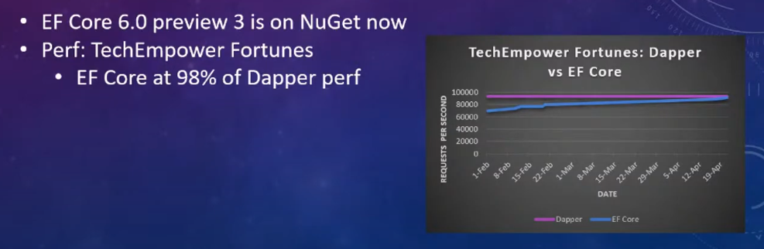
Entity Framework Core
Entity Framework (EF) Core is a lightweight, extensible, open source and cross-platform version of the popular Entity Framework data access technology.

Slide 6
Model development approaches
Generate a model from an existing database.
Hand-code a model to match the database.
Once a model is created, use EF Migrations to create a database from the model. Migrations allow evolving the database as the model changes.

Slide 7
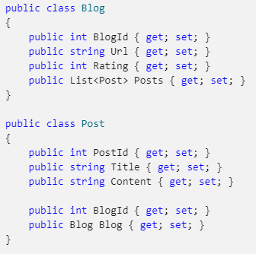
Model

Slide 8
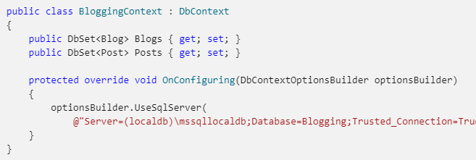
Context

Slide 9
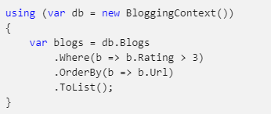
Querying

Slide 10
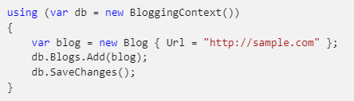
Save changes

Slide 11
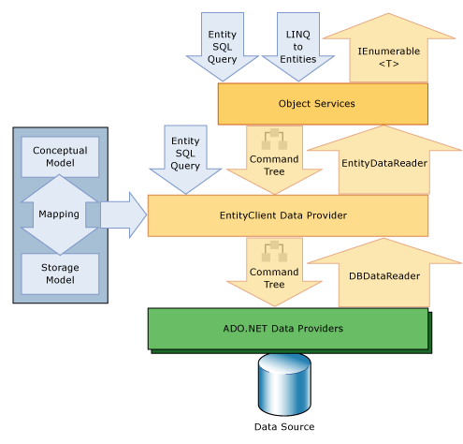
Access and change entity data
The following diagram illustrates the Entity Framework architecture for accessing data

Slide 12
Installation
Install-Package Microsoft.EntityFrameworkCore
Install-Package Microsoft.EntityFrameworkCore.Design
Install-Package Microsoft.EntityFrameworkCore.Tools
driver for database. For example:
Install-Package Npgsql.EntityFrameworkCore.PostgreSQL

Slide 13
IEnumerable vs IQueryable
IQueryable<T> extends the IEnumerable<T> interface
IQueryable<T> has:
query provider
query expression

Slide 14
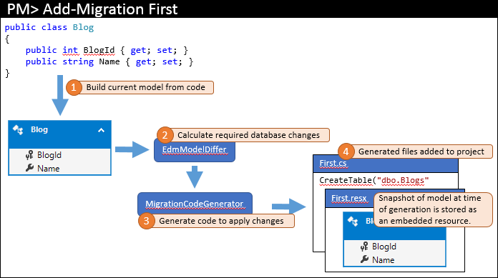
Migrations
dotnet tool install --global dotnet-ef
dotnet add package Microsoft.EntityFrameworkCore.Design
dotnet ef migrations add InitialCreate
dotnet ef database update
migrations also generates some additional code-behind files. These files are metadata that is used by migrations. One of these files is a resource file (.resx) that contains a snapshot of the model at the time the migration was generated.

