Slide 1
Software testing

Slide 2
Software testing
Software testing is the process of evaluating and verifying that a software application or system functions as expected. The primary goal is to identify and fix defects, ensure that the software meets the specified requirements, and provide a reliable and stable product. Software testing can be done manually or using automated tools.

Slide 3
Goals
Detecting defects: Identifying bugs or issues that could cause the software to fail or behave incorrectly.
Ensuring functionality: Verifying that the software performs the tasks it was designed to do, according to the specified requirements.
Improving quality: Ensuring the software meets user expectations and functions smoothly without major problems.
Validating security: Identifying vulnerabilities or weaknesses that could expose the software to attacks.
Enhancing performance: Checking if the software performs efficiently under various conditions, such as load testing or stress testing.

Slide 4
Software Testing vs Quality Assurance
Software testing and quality assurance (QA) are two related but distinct processes within the software development life cycle. Software testing is the process of identifying and verifying that software applications or programs will meet the user’s requirements, and quality assurance is the process of ensuring that the software meets the set standards of quality.
Software testing could be a part of a software quality assurance (SQA) process. In SQA, qa specialists are concerned with the software development process rather than just the artifacts (documentation, code and systems). They examine and change the software engineering process itself to reduce the number of faults that end up in the delivered software: the so-called defect rate.

Slide 5
Test process
Test strategy - is an outline that describes the testing approach of the software development cycle. The purpose of a test strategy is to provide a rational deduction from organizational, high-level objectives to actual test activities to meet those objectives from a quality assurance perspective.
A test plan is a document detailing the objectives, resources, and processes for a specific test session for a software or hardware product.

Slide 6
Test case
Test case is a specification of the inputs, execution conditions, testing procedure, and expected results that define a single test to be executed to achieve a particular software testing objective

Slide 7
Typical written test case format
Test case ID - A unique identifier for the test case.
Description/summary - The test case objective.
Test steps - The exact steps to perform.
Expected result - The expected outcome and how to determine whether it has been realized.
Actual result
Pre-requisites - Conditions that must exist or preparation required before test execution.
Test category
Author - name of the tester.
Automation - whether this test case is automated or not and, if so, how.
Pass/fail
Remarks

Slide 8
Code coverage
Code coverage, also called test coverage, is a percentage measure of the degree to which the source code of a program is executed when a particular test suite is run.
Function coverage
Statement coverage
Branch coverage

Slide 9
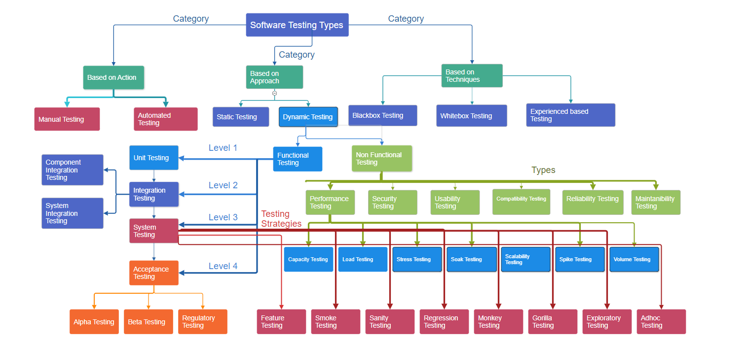

Slide 10
Functional testing
Functional testing is a form of software system testing that verifies whether software matches its design.
Types:
Unit testing
Integration testing
System testing
Acceptance testing

Slide 11
Types of system testing
Feature testing - for newly added features
Smoke testing - minimal set of tests to check critical functionality
Sanity testing - short but deep check for selected functionality
Regression testing - re-running tests to check is software still performs as expected
Monkey testing (smart or dumb) - test by providing random inputs
Gorilla testing - highly focused on specific feature
Exploratory testing - way to create new tests based on tests results
Ad-hock testing - performed without initial test case documentation

Slide 12
Non-functional testing
Non-functional testing is testing software for its non-functional requirements: the way a system operates, rather than specific behaviors of that system. This is in contrast to functional testing, which tests against functional requirements that describe the functions of a system and its components.
Accessibility testing
Baseline testing
Compliance testing
Documentation testing
Endurance testing or reliability testing
Load testing
Localization testing and
Internationalization testing
Performance testing
Recovery testing
Resilience testing
Security testing
Scalability testing
Stress testing
Usability testing
Volume testing

Slide 13
Software testing tactics
White-box testing - internal perspective of the system (the source code), is used to design test cases
Black-box testing - describes designing test cases without knowledge of the implementation, without reading the source code
Grey-box testing - involves using knowledge of internal data structures and algorithms for purposes of designing tests while executing those tests at the user, or black-box level

Slide 14
Automated testing
In software testing, test automation is the use of software separate from the software being tested to control the execution of tests and the comparison of actual outcomes with predicted outcomes
Levels:
Unit testing
Integration testing
System testing

Slide 15
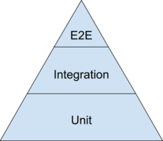
Unit, integration, and end-to-end levels
Unit tests: These are tests that test individual components or units of code in isolation. They are fast, reliable, and isolate failures to small units of code.
Integration tests: These tests check how different units of code work together. Although individual units may function properly on their own, integration tests ensure that they operate together coherently.
End-to-end tests: These test the system as a whole, simulating real-world usage scenarios. They are the slowest and most complex tests.

Slide 16
What Test Cases to Automate
Repetitive tests that run for multiple builds.
Tests that tend to cause human error.
Tests that require multiple data sets.
Frequently used functionality that introduces high risk conditions.
Tests that are impossible to perform manually.
Tests that run on several different hardware or software platforms and configurations.
Tests that take a lot of effort and time when manual testing.

Slide 17
Arrange-Act-Assert
Arrange-Act-Assert is a great way to structure test cases. It prescribes an order of operations:
Arrange inputs and targets. Arrange steps should set up the test case. Does the test require any objects or special settings? Does it need to prep a database? Does it need to log into a web app? Handle all of these operations at the start of the test.
Act on the target behavior. Act steps should cover the main thing to be tested. This could be calling a function or method, calling a REST API, or interacting with a web page. Keep actions focused on the target behavior.
Assert expected outcomes. Act steps should elicit some sort of response. Assert steps verify the goodness or badness of that response. Sometimes, assertions are as simple as checking numeric or string values. Other times, they may require checking multiple facets of a system. Assertions will ultimately determine if the test passes or fails.

